Slide 1

Presentation on TechifyIndia Organization
GURURAJ BIRADAR
393CS21

Slide 2
Overview of the Organization:
TechifyIndia is a start-up for providing IT solutions, building innovative IoT products providing systems integration solutions and technology provider, established to provide leading edge intelligent technical solutions and consulting services to businesses
Since 2017, the company have been providing consulting service like:(website development, design services, IoT, application development and technical support) to clients in various industries
Our creative team brings business to the next level of digitalization with mobile apps and internet marketing to improve branding and lead generation to succeed.

Slide 3
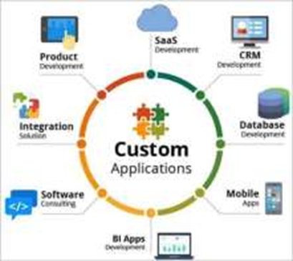



What Techify India do?

Slide 4
Vision and mission of the organization:
Our vision is to build upon a reputation of being one of the most innovative IT Solution and Service provider.
The mission of the organization is, To produce excellent services in the field of IT Services and Consultancy with maximum efforts driven towards customer satisfaction.
The company's vision and mission reflect its dedication to creating a positive impact on the industry and society

Slide 5
Organization structure:
The organization operates under a Functional structure, with several departments and divisions responsible for different aspects of the company's operations.
It is characterized by the division of the company into different functional areas, such as marketing, finance, operations, and human resources. Each functional area is headed by a manager who oversees the activities of their team.
The executive team consists of 12 members, with the CEO being the highest-ranking member of the organization.
The organization's structure ensures that each department operates efficiently and effectively while working towards the company's goals.

Slide 6
Roles and Responsibilities of personnel in the organization:
The roles and responsibilities of personnel within the organization vary depending on their job functions and departmental affiliations.
the common roles within the organization include
CEO, Marketing management, Developers, H-R management, etc,

Slide 7
Products and market performance:
TECHIFYINDIA Software Solution’s strength lies in understanding the client’s business processes, culture, vision and goals across the industry segments and offering client oriented solutions which are highly reliable, creating customer comfort. Few of our products are listed below.
Cashew Soft ERP
TAX-E(GST Billing)
CNC Monitoring
IOT Based Smart Bell, etc

Slide 8
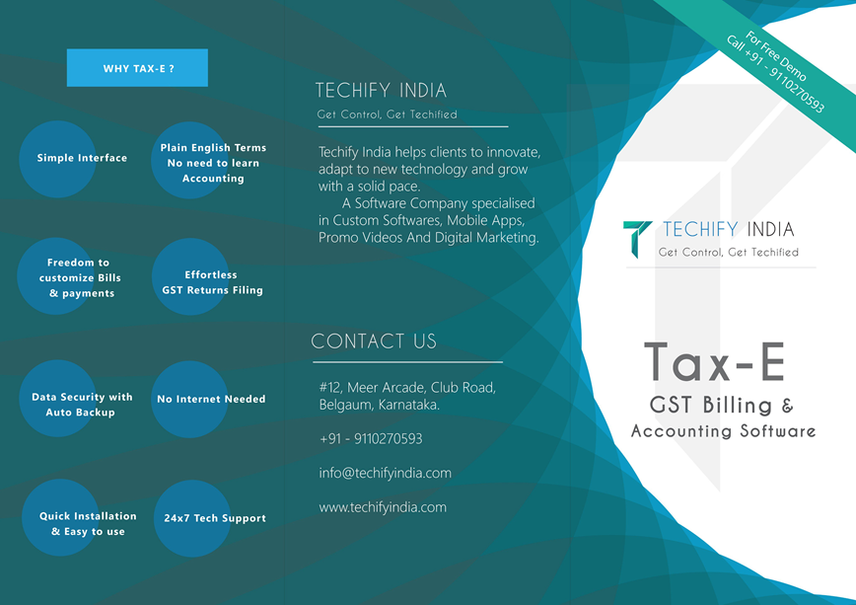
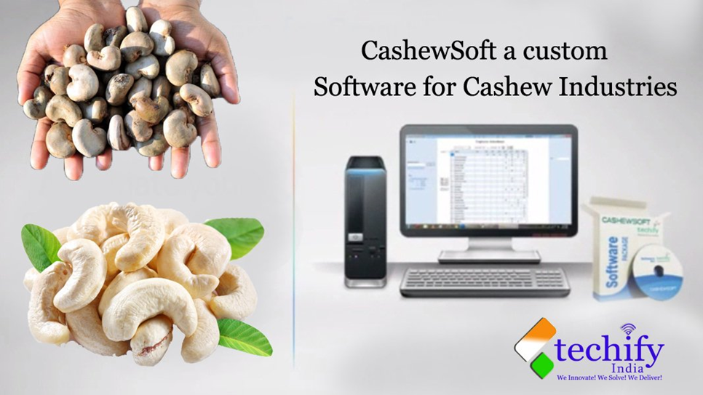

Slide 12


Slide 13
CONCLUSION
In conclusion, I hope that this presentation has given you a clear understanding of our company and the value that we can bring to your business. Our team is dedicated to providing high-quality products/services, excellent customer service, and innovative solutions to meet your needs.
We believe that by working together, we can achieve great success and create a long-lasting partnership. We are committed to earning your trust and delivering results that exceed your expectations.
Thank you for your time and consideration, and we look forward to the opportunity to work with you.

Slide 14
Thank You

